Slide 1
Balance of Payments

Slide 2
Definition of Balance of Payments
The balance of payments (BOP) is a statistical record of all international economic transactions between the residents of the home country and the residents of all other foreign countries over a certain period of time.

Slide 3
Why do we need to study balance of payments?
Home-and host-country BOP data is important as:
An indication of pressure on a country’s foreign exchange rate.
A signal of the imposition or removal of controls in various sorts of payments (dividends, interest, license fees, royalties and other cash disbursements).
A forecast of a country’s market potential (especially in the short run).
Notes:
Especially when compare the published data with anticipated date

Slide 4
Learning Objectives
Explore the fundamentals of balance of payments accounting, how nations measure their own levels of international economic activity.
Examine the two fundamental accounts of the balance of payments—the current account and financial account
Describe how changes in the balance of payments impact key macroeconomic rates—interest rates, exchange rates, and inflation rates.

Slide 5
Fundamentals of BOP Accounting
There are three main elements of measuring international economic activity:
Identifying what is and is not an international economic transaction.
Understanding how the flow of goods, services, assets, and money creates debits and credits to the overall BOP.
Understanding the bookkeeping procedures for BOP accounting.

Slide 6
Identifying what is and is not an international economic transaction.
A U.S. based firm manages the construction of a major water treatment facility in Bangkok, Thailand.
The U.S. subsidiary of a French firm pays profit back to its parent firm in Paris.
A U.S. tourist purchases a small necklace in Finland.
A Mexican lawyer purchase a U.S. corporate bond through an investment broker in Chicago.
The financial aid provided by U.S. government to Tanzania.
BOP has five different sub-accounts to record different types of international economic transactions.

Slide 7
Accounts of the Balance of Payments
Current Account (exchange of real assets, e.g. goods, services).
Goods trade (dominate component).
Services trade (e.g. legal, consulting, and engineering services, royalties for patents and intellectual properties, insurance premiums, shipping fees, and tourist expenditures).
Income (income generated by previous investment, e.g. dividend).
Current transfers (gift and grant).
Financial Account (exchange of financial assets, e.g. stocks, bonds, loans, companies).
Direct investment (investor acquires control of the foreign business (build or buy, 10% ownership threshold).
Portfolio investment (sales and purchases of foreign financial assets that do not involve a transfer of control, risk and return).
Other asset investment(transactions in currency, bank deposits, trade credits).
Capital Account (capital transfers that offset transactions without exchange of fixed assets or in their financing).
Debt forgiveness, franchise, transfer of patent, and copy right.

Slide 8
Accounts of the Balance of Payments (Cont.)
The Official Reserves Account (int'l reserve assets, e.g. gold, dollars, foreign exchanges, SDRs).
The significance depends on a country is under fixed or floating exchange rate regimes.
Net Error and Omissions Account.

Slide 9
Understanding how the flow of goods, services, assets, and money creates debits and credits to the overall BOP.
BOP is a flow statement, follow the cash flow.
Credit (+) for receipt from foreigners (inflow of capital).
E.g. export of a good or service, financial inflows.
Debit (-) for payment to foreigners (outflow of capital)
E.g. imports or purchases of services, financial outflows.

Slide 10
Understanding the bookkeeping procedures for BOP accounting.
Double-entry bookkeeping.
Every credit entry will be matched with a debit entry.
A sub-account may be imbalanced, but the entire BOP of a single country must be balanced.

Slide 11
Double-entry Bookkeeping- Example 1
Suppose that Boeing Corporation exported a Boeing 747 aircraft to Japan Airlines for $50 million, and that Japan Airlines pays from its dollar bank account kept with Chase Manhattan Bank in New York City.
 | Credit | Debit
Boeing’s export | $50m
Withdrawal from U.S. bank |  | -$50m

Slide 12
Double-entry Bookkeeping- Example 2
Suppose, for another example, that Boeing imports jet engines produced by Rolls-Royce for $30 million, and that Boeing makes payment by transferring the funds to a New York bank account kept by Rolls-Royce.
 | Credit | Debit
Boeing’s import |  | -$30m
Deposit at U.S. bank | $30m

Slide 13
Double-entry Bookkeeping- Example 3
Thomson Corporation, a U.S. information services company, acquires Reuters, a British news agency, for $750 million, and that Reuters deposits the money in Barclays Bank in London, which, in turn, uses the sum to purchase U.S. treasury notes.
 | Credit | Debit
Thomson's acquisition of Reuters |  | -$750m
Barclays’ purchase of U.S. securities | $750m

Slide 14
Double-entry Bookkeeping- Example 4
A U.S. citizen consumes a meal at a restaurant in Paris and pays $20 with her American Express card.
 | Credit | Debit
U.S. citizen having a meal in Paris |  | -$20
Paying the meal with American Express | $20

Slide 15
BOP and Key Macroeconomic Rates
A country’s balance of payments both impacts and is impacted by the three macroeconomic rates of international finance:
Exchange rates
Interest rates
Inflation rates

Slide 16
BOP and Exchange Rates
Current account balance + Financial account balance + Official reserve account balance=0
CA+FA+RA=0, overall balance is zero.
Fixed Exchange Rate Countries
Under a fixed exchange rate system, the government bears the responsibility to ensure that the BOP is near zero.
CA+FA>0, a surplus demand for domestic currency, then government need to buy official reserve assets, sell domestic currency to raise supply, RA<0.
CA+FA<0, an excess supply of domestic currency then government need to sell official reserve assets, buy domestic currency to raise demand, RA>0.
Floating Exchange Rate Countries
Under a floating exchange rate system, the government has no responsibility to peg its foreign exchange rate.
Exchange rate adjust automatically to make overall balance is zero, CA+FA=0

Slide 17
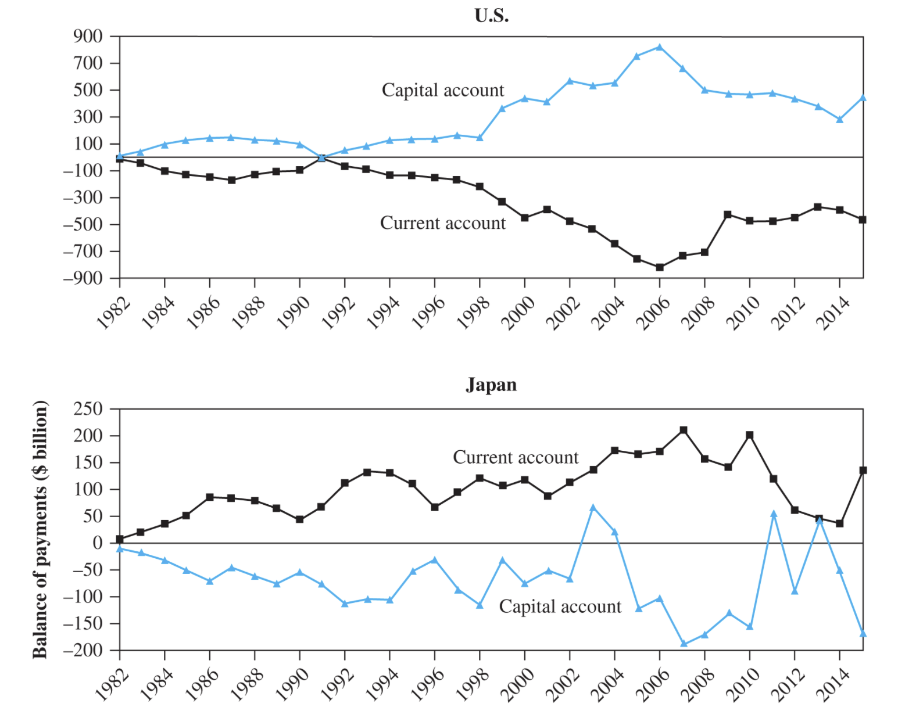
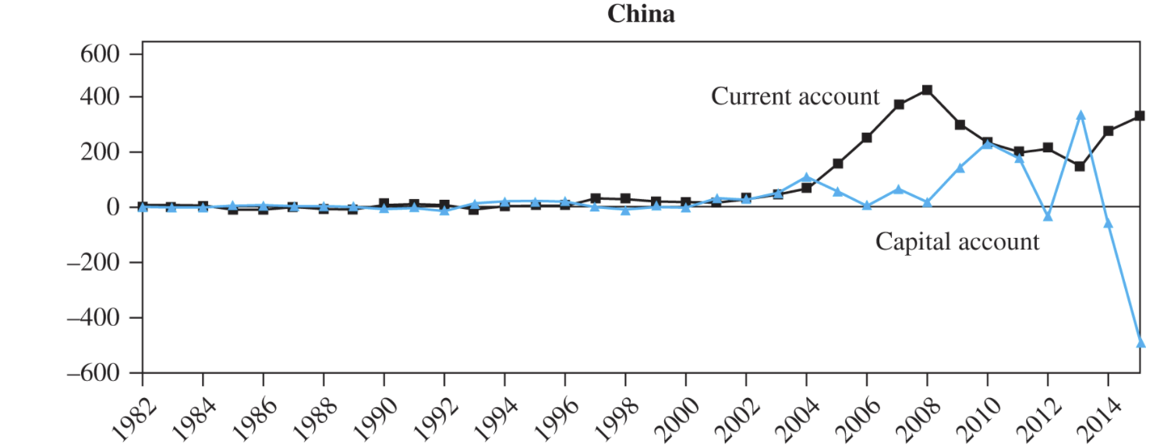
Financial account
Financial account
Financial account

Slide 18
BOP and Interest Rates
The overall level of a country’s interest rates compared to other countries has an impact on the financial account of balance of payment.
Relatively low real interest rates should normally stimulate an outflow of capital seeking higher rates elsewhere.
The opposite has occurred in the U.S. due to perceived growth opportunities and political stability—allowing it to finance its large fiscal deficit.

Slide 19
BOP and Inflation Rates
If a country’s inflation rate increases relative to the countries with which it trades, this could cause its exports to decrease, and imports to increase.
Imports have the potential to lower a country’s inflation rate.
Imports of lower priced goods and services place a limit on what domestic competitors can charge for comparable ones. It helps maintain a lower rate of inflation than might have been the case without imports.

Slide 20
Summary (Learning Objectives Revisit)
Explore the fundamentals of balance of payments accounting, how nations measure their own levels of international economic activity.
Examine the two fundamental accounts of the balance of payments—the current account and financial account
Describe how changes in the balance of payments impact key macroeconomic rates—interest rates, exchange rates, and inflation rates.

